Slide 1
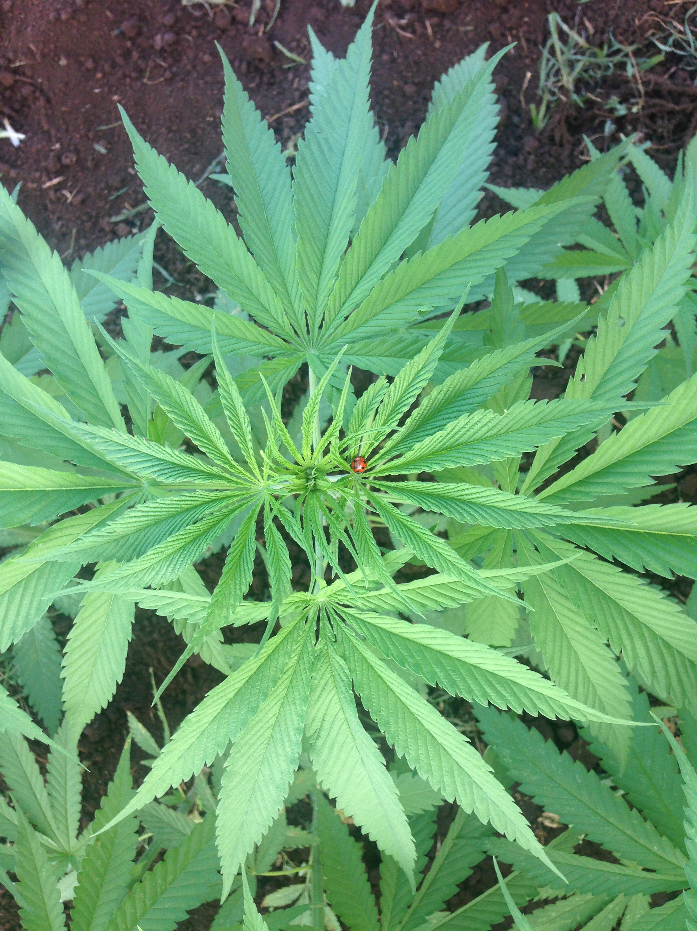
INDUSTRIAL HEMP
IN HAWAI`I
UNIVERSITY OF HAWAI`I AT MANOA PROJECTS
and
HDOA LICENSING PROGRAM FOR FARMERS
By
Melody Heidel
Industrial Hemp Project Manager
UH-Manoa, CTAHR, MBBE
August 7, 2018

Slide 2
WHAT IS INDUSTRIAL HEMP?
Hemp is Cannabis sativa containing LESS THAN 0.3% THC.
It DOES NOT have any psychoactive properties.
Its fibers, seed, seed meal, and seed oil are harvested and can be used to manufacture myriad products, including those made from cotton, petroleum and timber.
  Imagine the positive impact on Hawaii’s import security and disaster preparedness (and costs) if items like toilet paper and building materials were produced here!
Its seed is very nutritious and its oil is used in beauty products.
It is also contains CBD (cannabidiol), a NON-psychoactive compound used to treat medical issues such as seizures, pain, inflammation, etc.
Fast growing, weed suppressant, drought tolerant. Can handle wet areas IF good drainage.
Known for being pest resistant elsewhere (still assessing pest impact in Hawaii microclimates).

Slide 3
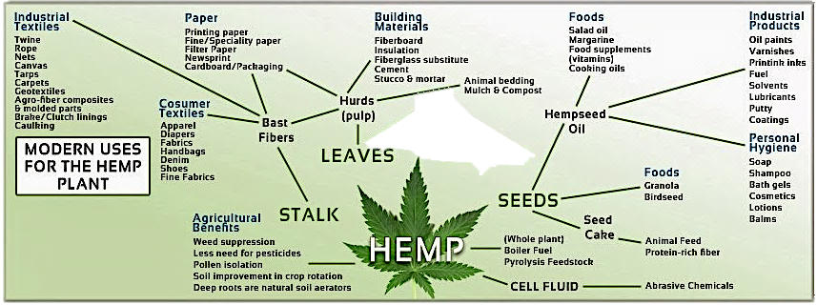
Parts, Products, and Uses
Fiber, bioplastics, hempcrete, nutrition, beauty products, value-added products, biofuel, animal feed, autoparts, supercapacitors, phytoremediation, erosion control, windbreak, crop rotation
Image source: www.eco-canna.com

Slide 4
A Brief History of Hemp
Industrial hemp been grown throughout the world for millennia, for textiles and food. Most countries have continued to grow hemp and have developed advanced industries. We need to catch up to and learn from them!
  Example: Public housing complex in England built from hempcrete
The United States historically grew hemp as well, including a Hemp for Victory campaign by the US Government during WWII encouraging farmers to grow hemp in support of the war effort.
  Fun Fact: The Declaration of Independence was written on hemp paper.
The US Government effectively outlawed hemp in the 1950s when the Federal Bureau of Narcotics erroneously lumped it in with psychoactive forms of cannabis; DEA continues this policy. There is a growing national effort to change this regulation.
Current Federal regulation defines hemp as containing < 0.3% THC; this could change to < 1% THC in the future.
The 2014 Federal Farm Bill allowed universities and State Departments of Agriculture to grow hemp and establish pilot programs for farmers.

Slide 5
US States With Hemp Legislation and Pilot Programs
40 states have defined industrial hemp as distinct and removed barriers to its production:
    Alabama, Alaska, Arizona, Arkansas, California, Colorado, Connecticut, Delaware, Florida, Hawaii, Illinois, Indiana, Kansas, Kentucky, Maine, Maryland, Massachusetts, Michigan, Minnesota, Missouri, Montana, Nebraska, Nevada, New Mexico, New York, North Carolina, North Dakota, Oklahoma, Oregon, Pennsylvania, Rhode Island, South Carolina, Tennessee, Utah, Vermont, Virginia, Washington, West Virginia, Wisconsin, and Wyoming.
19 states had hemp pilot programs or research in 2017.
Source: www.votehemp.com

Slide 6
UH-Manoa
Industrial Hemp Projects
Mandated by the State of Hawai`i Legislature
    1998-2001 Pilot Project (varietal trials)
    2015-2016 Pilot Project (varietal trials)
    2016 HDOA Pilot Program to license farmers
2017-2018 HDOA Seed Multiplication Contract
    Principal Investigator: Dr. Qing Li, CTAHR, MBBE Dept.
    Two other private contracts awarded on Maui & Big Island
Multi-disciplinary collaboration (College of Engineering).

Slide 7
UH-Manoa Project Findings
2015-16 results*
*from different subtropical cultivar than that used in 2018
    Potential for 2-3 crops per year (compared to 1 in temperate climates) = yields of between 27-38 tons of fiber and forage material and approximately 2.5 tons of seed per acre, per year.
    ~4 month lifecycle
    Long photoperiod: 12+ hours daylight preferable
    Phytoremediation: In 6 weeks, hemp removed 75% of the herbicide atrazine (commonly used on sugarcane and pineapple) from soil
    Anti-adipogenic activity, an exciting indicator of hemp’s potential in obesity and diabetes research.

Slide 8
UH-Manoa Project Findings
2018 observations (Yuma, subtropical Chinese cultivar)
  Hemp practically grows itself!
  Potential for greater income/acre
  Photoperiod, microclimate can impact growth
  Plant needs: sufficient nitrogen; limited water after germination; some minimal, preventative pest control
  Potential pests: slugs/snails, birds, ants, spittle bug, stink bug.
    Some impact keiki, others impact maturing seed
    NOT bothered by pigs, chickens
  Challenges:
    Variability of Yuma seed: germination and growth rates, seed yield
        Selective breeding opportunity
    Equipment and Infrastructure: planting, harvesting, processing, manufacturing
        Cottage industry level? Small farmer cooperatives? State assistance?

Slide 9
UH-Manoa Project Findings
Continued: 2018 observations (Yuma cultivar)
  Initial yields:
    January planting: 50% crop was male; 25% of crop produced seed at rate of 216 lbs or 0.1 ton/acre; IF 100% of crop had yielded seed, then x4 = 864 lbs or 0.4 tons/acre. IF 2 crops/year, then potential 0.8 tons/acre/year.
    Potential fiber yield was excellent (max height of 3.3 m/11 ft)
    May and June plantings should have higher yields (longer photoperiod).
  Industry standard seed yields (in general, for all seed cultivars), at 1 crop/year:
    Canada averages 600 - 800 lbs or 0.3 - 0.4 tons/acre
    Others claim between 100 – 1,200 lbs ( 0.05 - 0.6 tons) or 1,200 – 4,800 lbs (0.6 - 2.4 tons), depending on the source

Slide 10
Yuma cultivar available from HDOA
YUMA (data as of 8/1/2018) | PLOT 1 (1st gen. seed) | PLOT 2 (1st gen. seed) | PLOT 3 (2nd gen. seed)
Date Planted | January 16, 2018 | May 8, 2018 | June 5, 2018
Date sprouts emerge | Day 3 to 5 | Day 2 to 5 | Day 2 to 8
Germination rate (field planted) | 80 to 85% overall (ranged from 30% to 90% depending on seed size) | 80-95% | 80 to 85% overall (ranged from 35% to 95% depending on seed batch)
Height at 4 weeks | 4 cm to 23 cm (median 13 cm) | 5 cm to 40 cm (median 20 cm) | 1 cm to 33 cm (median 12 cm)
Height at 6 weeks | 18 cm to 1.27 m (median 70 cm) | 10 cm – 1.48 m (median 75 cm) | 1 cm to 1.1 m (median 40 cm)
Height at 8 weeks | 7 cm to 1.94 m (median 1.2 m) | 7 cm – 2.45 m (median 1.2 m) | 6 cm to 2.07 m (median 1.1 m)
Height at 12 weeks | 90 cm to 2.45 m (median 1.7 m) | 33 cm to 4.6 m (median 2.3 m) | N/A
Height at 16 weeks | 1.05 m to 3.25 m (median 2.3 m) | N/A | N/A
Final Height | Week 28: 1.69 m to 4.3 m (median 3.3 m) | N/A | N/A
Date 1st flowers develop | Week 4 (Feb. 12, 2018): male and female | Week 11 (July 24, 2018): male buds and some poss. female | Weeks 7-8: poss. females ID’d Week 9 (Aug.7): 1st male buds
Date 1st seeds appear | Week 8 (March 14, 2018) | N/A | N/A
Date of THC testing | Week 14 (April 24, 2018) | N/A | N/A
Date of seed harvest | Weeks 15 to 17 (May 1-14, 2018) | N/A (anticipate September) | N/A (anticipate October)
Date senesced | +/- Week 18 (May 24, 2018) *Week 29 (Aug. 7, 2018): Many dead; some still alive but ailing | N/A | N/A

Slide 11
Rules for Growing Hemp in Hawai`i
YOU MUST GET A LICENSE FROM HDOA TO GROW HEMP
Apply anytime; licenses issued every four months
(March, June, September, December)
Annual cost: $250 plus $2/acre (up to 10 acres per license)
HDOA website: www.hdoa.hawaii.gov/hemp
  information on cultivars and availability timeline
  compliance requirements (cultivar approval, THC testing, pesticide usage, security, reports)
  Program Contact: Shelley Choy
  shelley.n.choy@hawaii.gov or (808) 832-0676

Slide 12
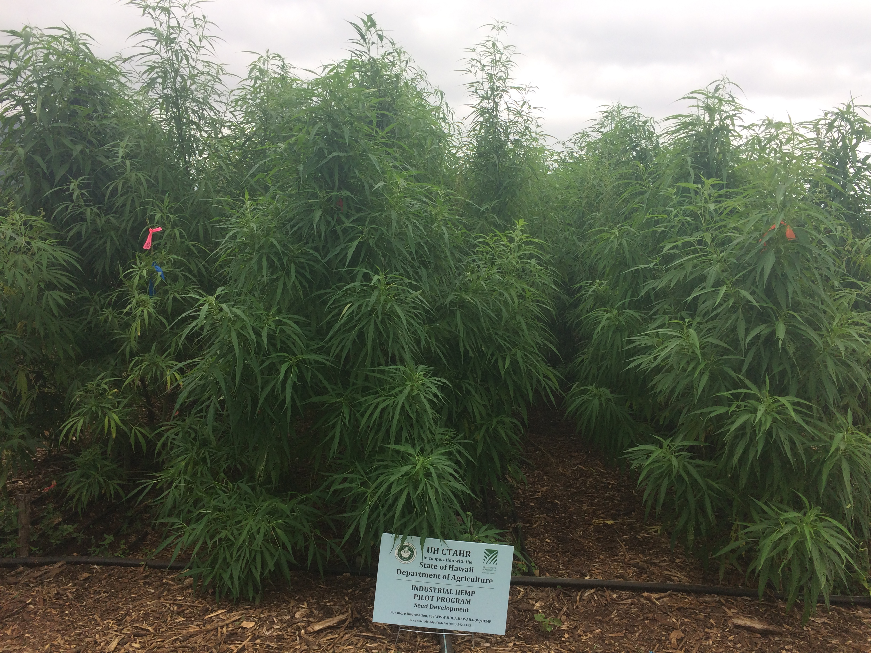
Hemp Informational Resources
www.votehemp.com
Hemp Farming Legislation, Information and Advocacy
www.naihc.org National Advisory in Hemp & CBD (includes link to 1913 USDA hemp farming guide)
www.civilbeat.org/2016/07/hemp-youve-come-a-long-way-baby
My Contact Info:
MELODY HEIDEL mheidel@hawaii.edu
Industrial Hemp Project Manager 808-542-4183
UH-Manoa, CTAHR, MBBE www.hawaiihempsolutions.com

